Slide 1


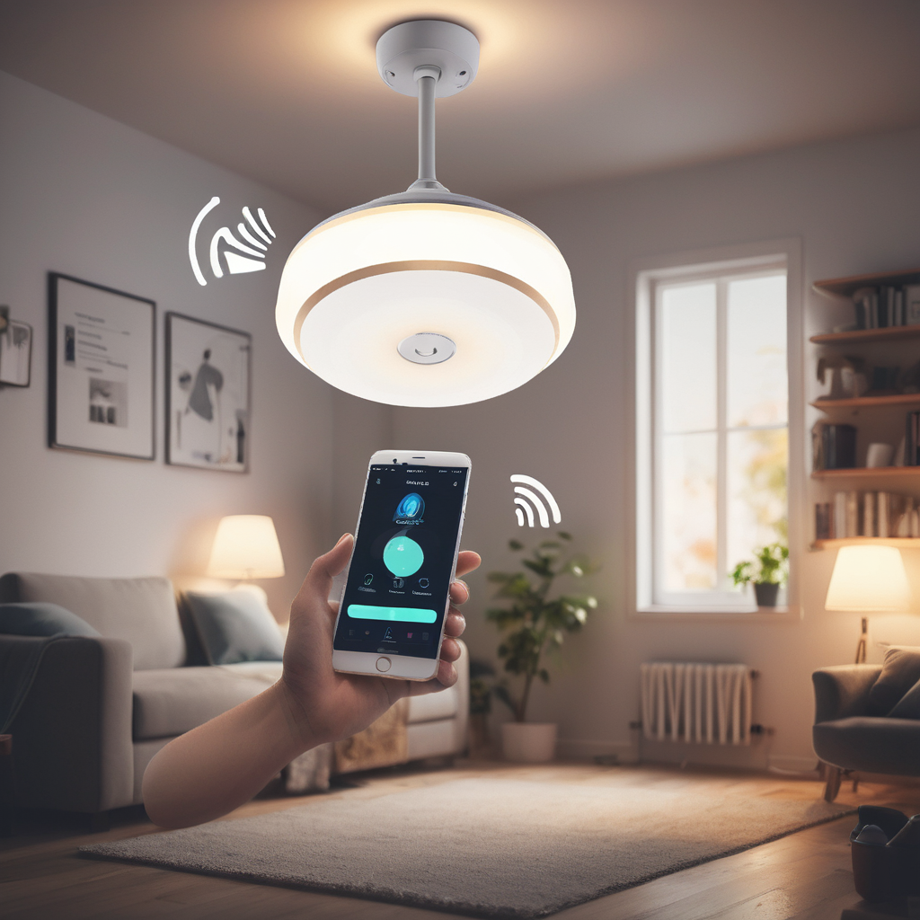

DEPARTMENT OF COMPUTER SCIENCE & ENGINEERING
SCHOOL OF COMPUTING
10214CS602 MINOR PROJECT -2
WINTER SEMESTER(2023-2024)
REVIEW II
“Voice Control - Home Automation”
PRESENTED BY
SUPERVISED BY
1. RAJA RAJA CHOZHAN V K (VTU18963)(21UECS0514)
2. RAJA B (VTU18964)(21UECS0513)
3. NANDAGOPAL J (VTU19087)(21UECS0408)
Mr. S. GOPI, M.Tech

Slide 2
OVERVIEW
ABSTRACT
OBJECTIVE
INTRODUCTION
LITERATURE REVIEW (SOFT COPY OF PAPERS TO BE LINKED AS HYPERLINK)
DESIGN AND METHODOLOGIES
IMPLEMENTATION
TESTING
INPUT AND OUTPUT
INCLUDE DEMO VIDEO-1 (Till REVEW-1)
INCLUDE DEMO VIDEO-2(Complete Implementation of Project)
CONCLUSION
WEB REFERENCES LINK (TILL REVIEW DATE ALL LINKS TO BE INCLUDED DAY WISE)
PLAGIARISM REPORT OF PPT
REFERENCES

Slide 3
ABSTRACT
Introduction:
Voice-controlled home automation system using Arduino and Android integration.
Enhances accessibility, efficiency, and energy-saving capabilities for users.
Aimed at catering to the needs of elderly, disabled, and tech-savvy individuals.
Purpose:
Design and implementation of a cost-effective and scalable solution for modern homes.
Provides convenient and intuitive interface for controlling household appliances through voice commands. Integration of Arduino microprocessor technology and Android smartphone for seamless operation.
Method:
Utilization of Arduino microprocessor technology for controlling household appliances.
Integration with Android smartphone/tablet for voice command input and wireless communication.
Incorporation of Bluetooth technology for establishing wireless connectivity between Arduino and Android devices. Development of an intuitive Android application for setup, configuration, and operation of the home automation system.
Result:
Successful implementation of voice-controlled operation for various household appliances.
Integration of an authentication mechanism to enhance security and privacy.
Establishment of seamless wireless connectivity between Arduino and Android devices via Bluetooth.

Slide 4
OBJECTIVES
Objective:
The objective of the project is to design and implement a voice-controlled home automation system that enhances accessibility, efficiency, and energy-saving capabilities for users.
This system aims to provide a convenient and intuitive interface for controlling household appliances through voice commands, thereby catering to the needs of elderly, disabled, and tech-savvy individuals alike. The project seeks to leverage Arduino microprocessor technology, coupled with Android smartphone integration and wireless communication, to create a cost-effective and scalable solution for modern homes.
Scope:
Voice-Controlled Operation: The system will enable users to control various household appliances, including lights, doors, fans, and air conditioners, using voice commands via an Android smartphone or tablet.
Authentication Mechanism: The project will incorporate an authentication mechanism to ensure that only authorized users can access and control the home automation system, thereby enhancing security and privacy.
Wireless Connectivity: Communication between the Arduino microprocessor and the Android device will be established using Bluetooth technology, enabling seamless remote access and control of home appliances.
Energy Efficiency: The system will focus on optimizing energy usage and promoting sustainability by allowing users to schedule appliance operations, monitor energy consumption, and implement energy-saving strategies.
User Interface: An intuitive and user-friendly Android application will be developed to facilitate easy setup, configuration, and operation of the home automation system, catering to users of all technical backgrounds.
Scalability and Flexibility: The project will be designed to be scalable and adaptable to different home environments and user preferences, allowing for future expansion and integration with additional smart devices and functionalities.

Slide 5
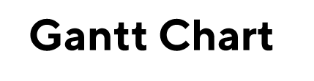
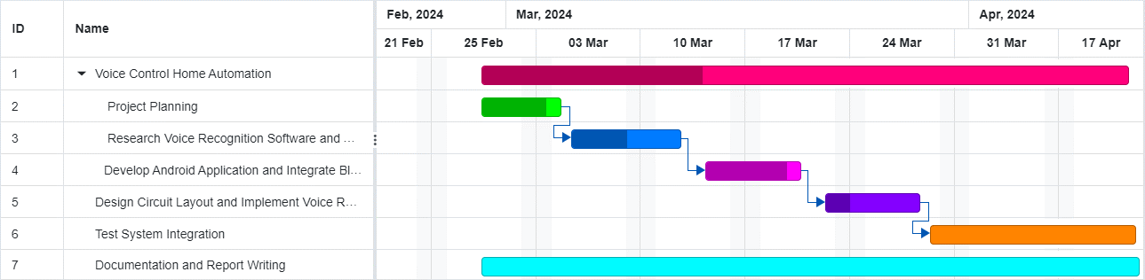
TIMELINE OF THE PROJECT

Slide 6
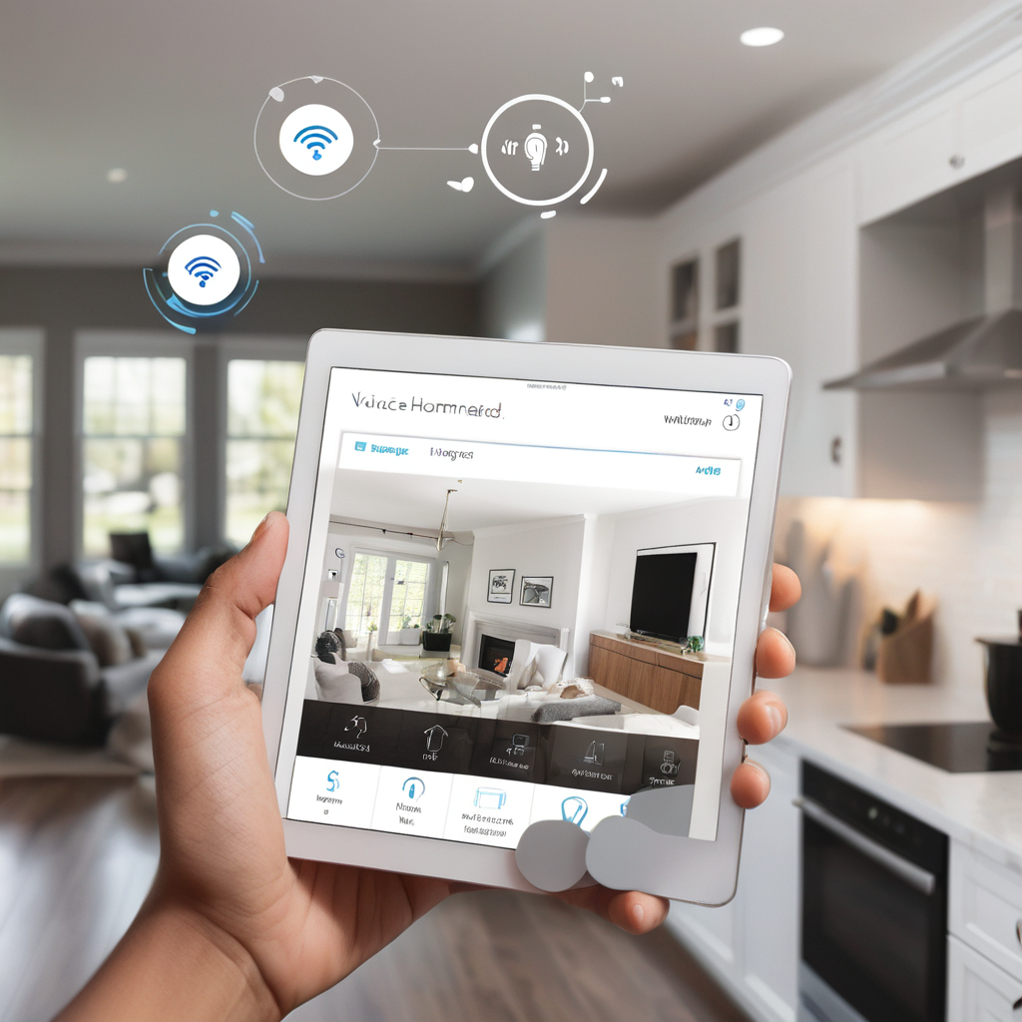
INTRODUCTION
Are you tired of manually controlling your household appliances? What if you could simply speak to control them?
Introducing an innovative voice-controlled home automation system designed to revolutionize the way individuals interact with their homes. Say goodbye to traditional switches and hello to the future of smart living with this voice-controlled solution.
This project combines cutting-edge Arduino technology with Android integration to create a seamless and intuitive user experience.
Explore the features, implementation, and benefits of this transformative home automation system, catering to the needs of aged and physically challenged individuals by enhancing accessibility, promoting independence, reducing physical strain, enhancing safety, and increasing convenience.

Slide 7
LITERATURE REVIEW
Author’s Name | Paper name and publication details | Year of publication | Main content of the paper
I. Froiz-Míguez, P. Fraga-Lamas, and T. M. Fernández-Caramé | Design, Implementation, and Practical Evaluation of a Voice Recognition Based IoT Home Automation System for Low-Resource Languages and Resource-Constrained Edge IoT Devices: A System for Galician and Mobile Opportunistic Scenarios | 2023 | Design, implementation, and evaluation of a voice recognition-based IoT home automation system tailored for low-resource languages and resource-constrained edge IoT devices.
T. Arif, A. Javed, M. Alhameed, F. Jeribi, and A. Tahir | Voice Spoofing Countermeasure for Logical Access Attacks Detection | 2021 | Introduction of a voice spoofing countermeasure to detect logical access attacks, employing techniques such as feature extraction, speech synthesis, and cepstral analysis.

Slide 8
3 | I. Butun and P. Österberg | A Review of Distributed Access Control for Blockchain Systems Towards Securing the Internet of Things | 2021 | Review of distributed access control mechanisms in blockchain systems for IoT security, covering blockchain technology, access control, peer-to-peer computing, and security protocols.
4 | M. Pourvahab and G. Ekbatanifard | An Efficient Forensics Architecture in Software-Defined Networking-IoT Using Blockchain Technology | 2019 | Efficient forensics architecture for SDN-IoT using blockchain to enhance IoT security through tamper-proof event logging.
5 | P. R. Pinheiro et al. | Integration of the Mobile Robot and Internet of Things to Monitor Older People | 2019 | Integration of mobile robots and IoT for monitoring older people, focusing on senior citizens, robot sensing systems, and IoT algorithms.
6 | A. Al-Nasheri et al. | Voice Pathology Detection and Classification Using Auto-Correlation and Entropy Features in Different Frequency Regions | 2019 | Method for voice pathology detection and classification using auto-correlation and entropy features across different frequency regions.

Slide 9
7 | A. Sehgal and N. Kehtarnavaz | A Convolutional Neural Network Smartphone App for Real-Time Voice Activity Detection | 2018 | Introduction of a convolutional neural network-based smartphone app for real-time voice activity detection.
8 | J. Mabrouki, M. Azrour, D. Dhiba, Y. Farhaoui, and S. E. Hajjaji | IoT-based data logger for weather monitoring using Arduino-based wireless sensor networks with remote graphical application and alerts | 2021 | IoT-based data logger system for weather monitoring using Arduino-based wireless sensor networks with remote graphical applications and alerts.

Slide 10
DESIGN AND METHODOLOGIES
MODULE 1: Serial Communication Algorithm

Slide 11
MODULE 1: Serial Communication Algorithm
Data Collection:
1. Bluetooth Data Reception:
The Arduino board receives data from an external device (presumably a smartphone or computer) via Bluetooth communication. This data is transmitted serially and received by the Arduino's serial port. The Arduino continuously checks for incoming data from the Bluetooth module using Serial.available() within the loop() function. As data becomes available (Serial.available() > 0), the Arduino reads the incoming bytes using Serial.read() and accumulates them into a string variable named data. The data received via Bluetooth typically includes commands or instructions for controlling various devices connected to the Arduino, such as relays, RGB LEDs, and IR signal recording/playback.
2. Infrared (IR) Signal Reception:
The Arduino also receives IR signals from remote controls using an IR receiver module. The received IR signals are processed to decode the protocol, address, and command of the transmitted IR signal. IR signal reception is handled using an interrupt service routine (ISR). When an IR signal is received, the ISR (handleReceivedIRData()) is triggered, which then retrieves and processes the IR data. The decoded IR data, including the protocol, address, and command, are stored in variables for further processing or action. The handleReceivedIRData() ISR sets a flag (sIRMPDataAvailable) to indicate that IR data is available for processing.

Slide 12
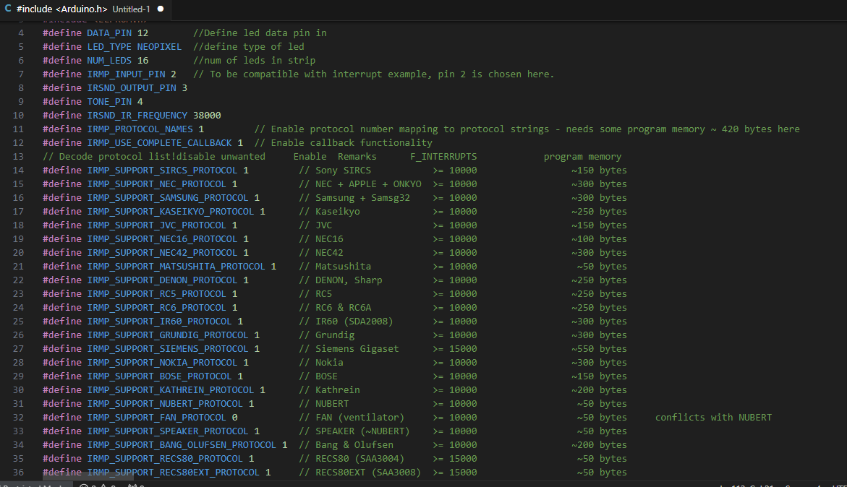
Step 2: Processing the data

Slide 13
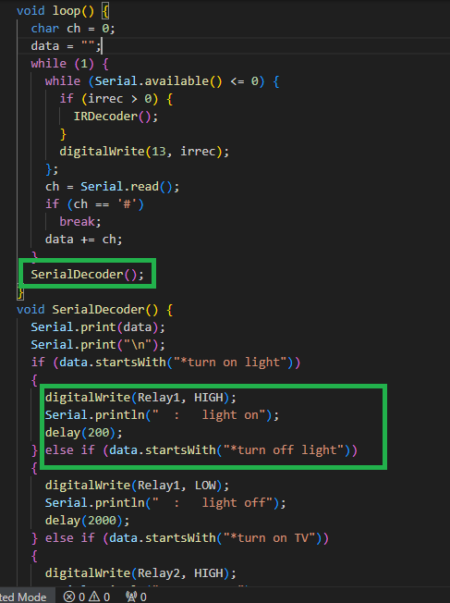
Step 3: Using Serial Communication Algorithm UART
In the setup() function, the serial communication is initialized with a baud rate of 9600.
In the loop() function, the program continuously checks for incoming data from the Bluetooth module.
Once data is available, it reads the characters until it receives a '#' character, which indicates the end of the command.
The received command is then passed to the SerialDecoder() function for processing.
Inside the SerialDecoder() function, various if-else statements are used to check the received command and trigger corresponding actions, such as turning on/off devices, controlling RGB LEDs, or recording IR signals.
Overall, this part of the code enables communication between the Arduino board and external devices via a Bluetooth module, allowing users to control household appliances and RGB LEDs using voice commands sent wirelessly to the Arduino.

Slide 14
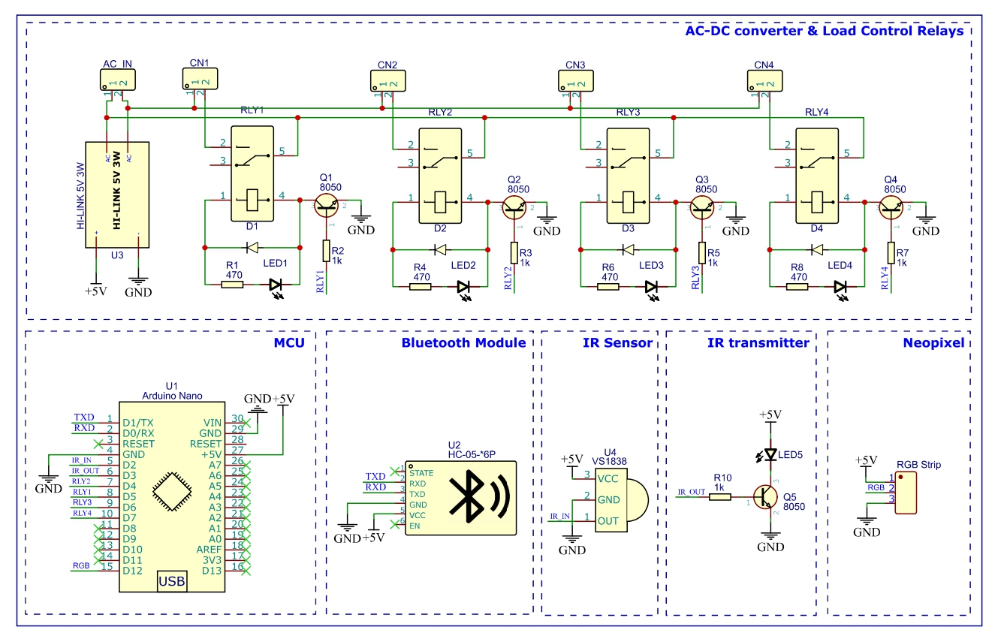
Step 4: The Circuit Diagram

Slide 15
IMPLEMENTATION
Architecture Diagram
Data –Flow Diagram
Use Case Diagram
Class Diagram
Activity Diagram
Sequence Diagram
Collaboration Diagram
E-R Diagram

Slide 16
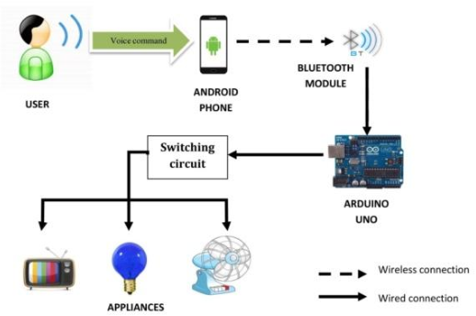
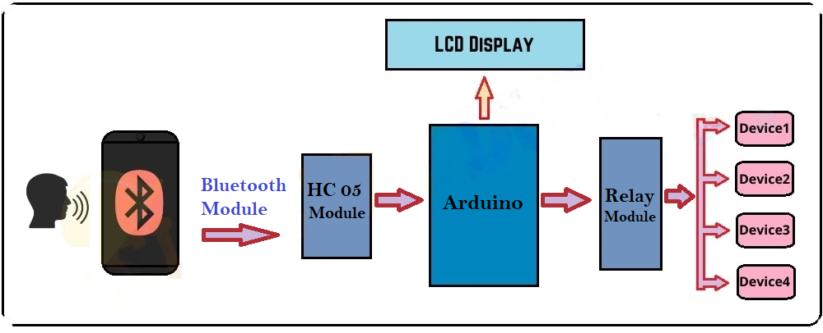
Architecture Diagram
Components Overview: Arduino microprocessor, Android smartphone, Bluetooth module, and household appliances.
Arduino Microprocessor: Central controller for receiving and processing voice commands.
Android Smartphone Integration: Interfaces with Arduino via Bluetooth for sending commands.
Bluetooth Communication: Enables wireless control between Android and Arduino.
Household Appliances: Lights, fans, doors, AC controlled via voice commands.
Authentication Mechanism: Secure access for users implemented if needed.
Energy Efficiency Features: Includes scheduling and energy monitoring capabilities.
Scalability and Flexibility: Designed for expansion and integration with smart devices.
User Interface: Simple interface for setup, configuration, and operation.
Overall Flow: Data and control signals flow from Android to Arduino to appliances.

Slide 17
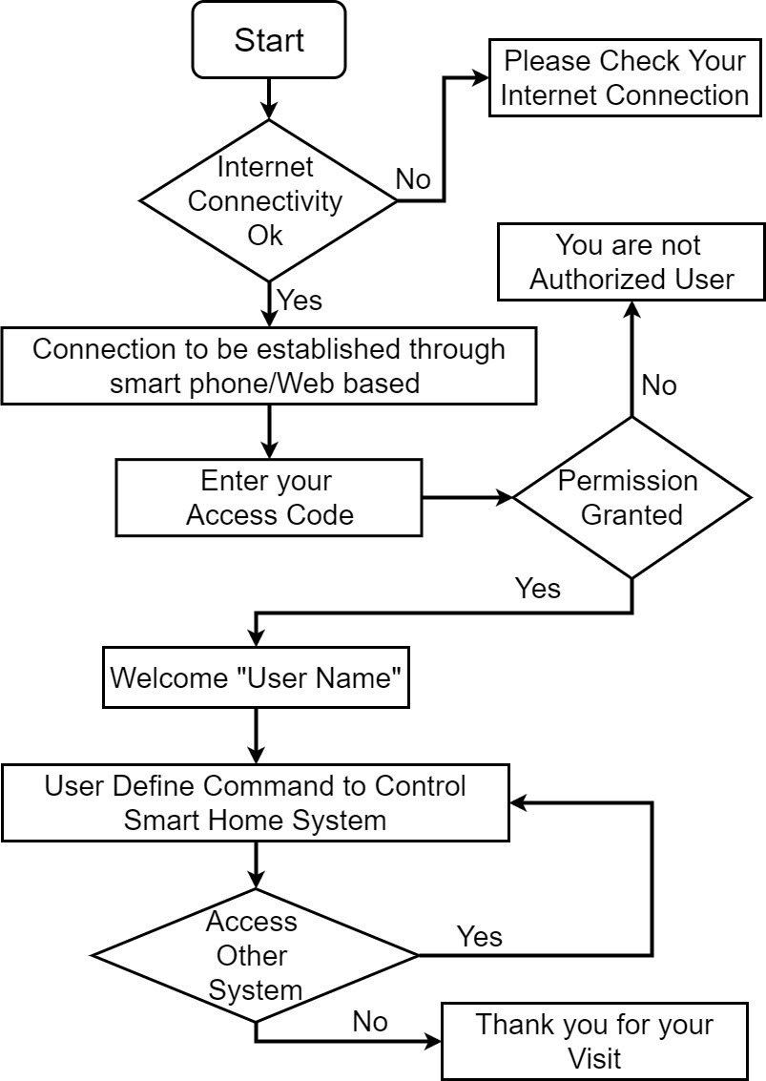
Data –Flow Diagram
Start: The process initiation point.
Internet Connectivity Check: Verifies if the user’s device is connected to the internet.
Connection Method: Determines whether the connection is established through a smartphone, web-based interface, or voice control.
Access Code Entry: The user is prompted to enter an access code for authentication.
Authorization: If the access code is correct, permission is granted; otherwise, access is denied.
System Control: Upon successful login, the user can control the smart home system or access other systems using the chosen method (smartphone, web interface, or voice commands).
Voice Recognition & Command Interpretation: If voice control is selected, a device with voice recognition capability listens for the user's commands, interprets the spoken words, and translates them into actions.
Control Signal: The interpreted commands are sent as signals to the respective appliances or systems.
Action Execution: The appliances or systems receive the signals and perform the requested actions, such as turning on lights or adjusting the thermostat.
Session End: The process concludes with a thank you message, marking the end of the session.

Slide 18
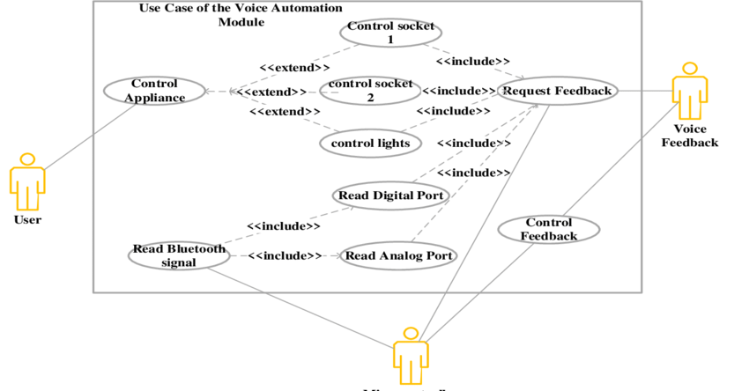
Use Case Diagram

Slide 19
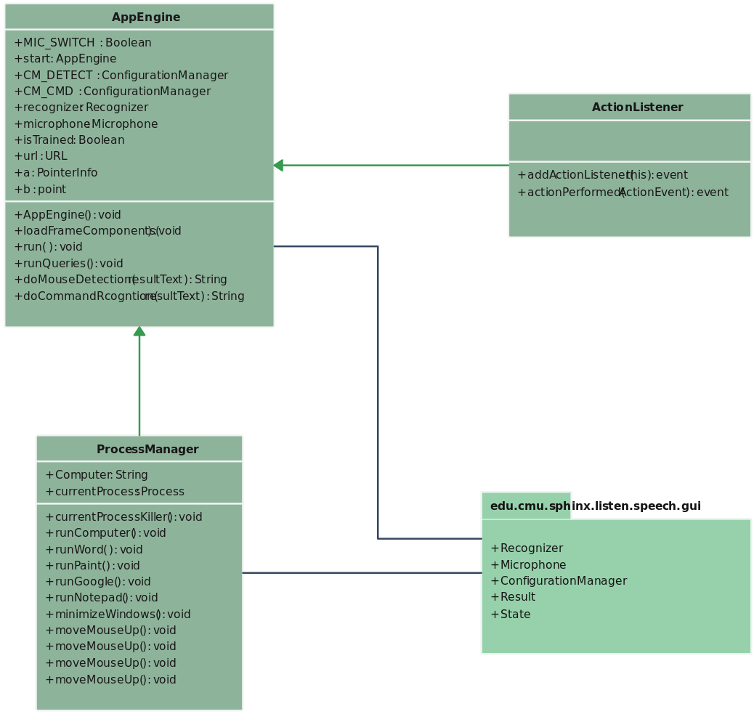
Class Diagram

Slide 20
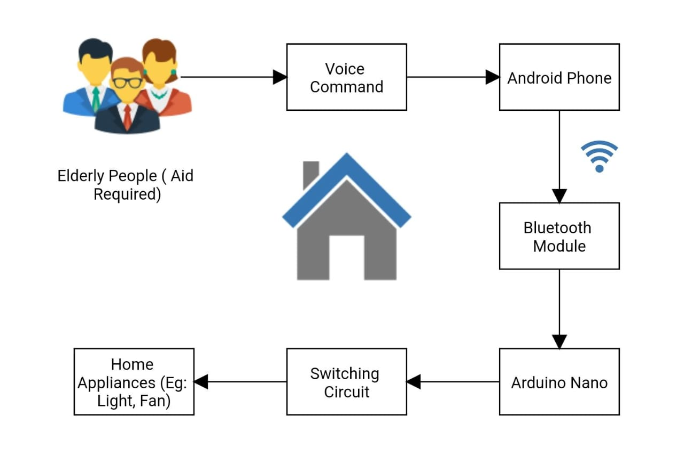
Activity Diagram

Slide 21
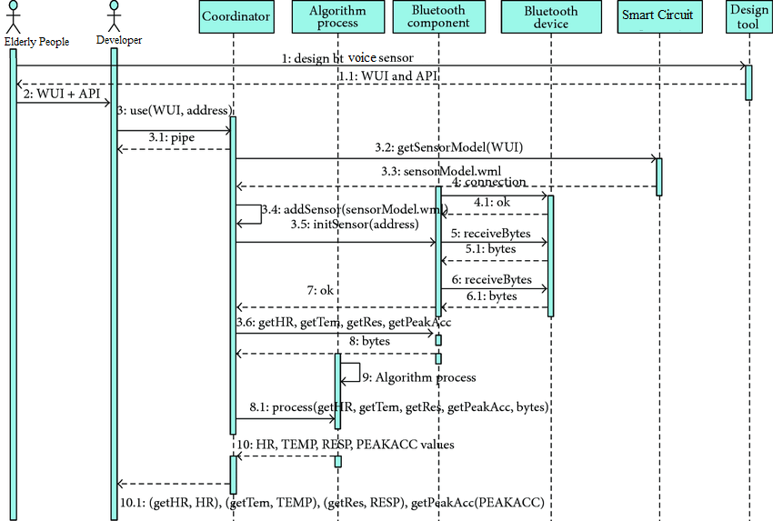
Sequence Diagram

Slide 22
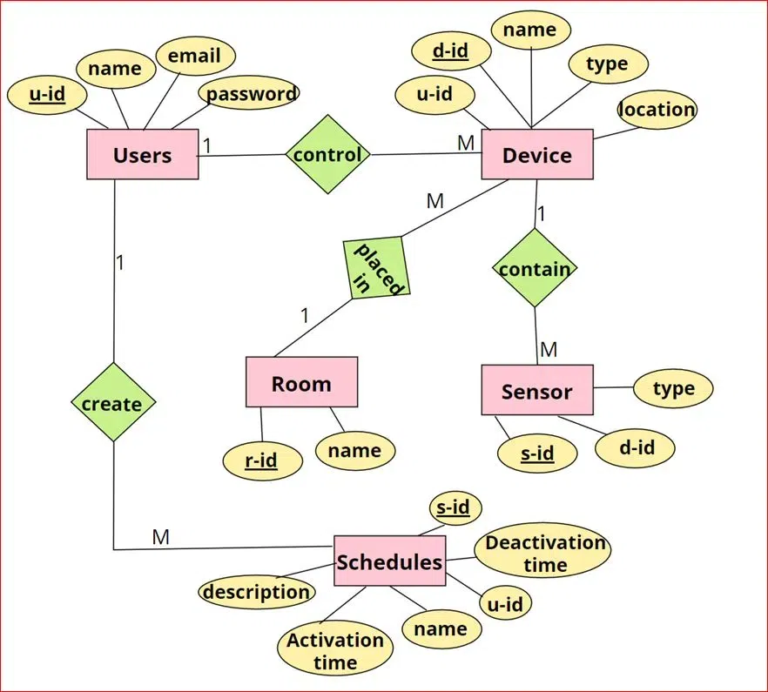
E-R Diagram

Slide 23
TESTING
UNIT TESTING
INTEGRATION TESTING
FUNCTIONAL TESTING
WHITE BOX TESTING
BLACK BOX TESTING

Slide 24
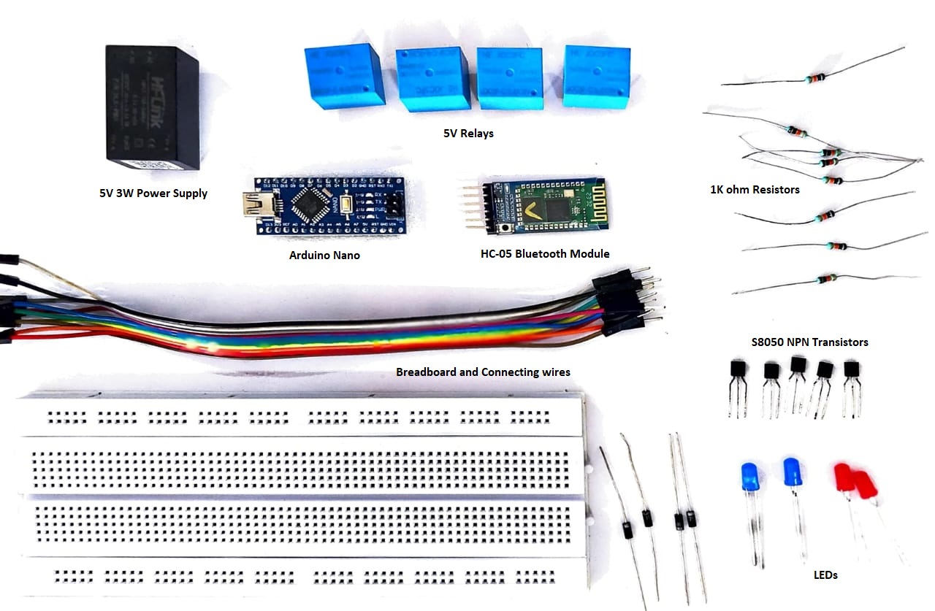
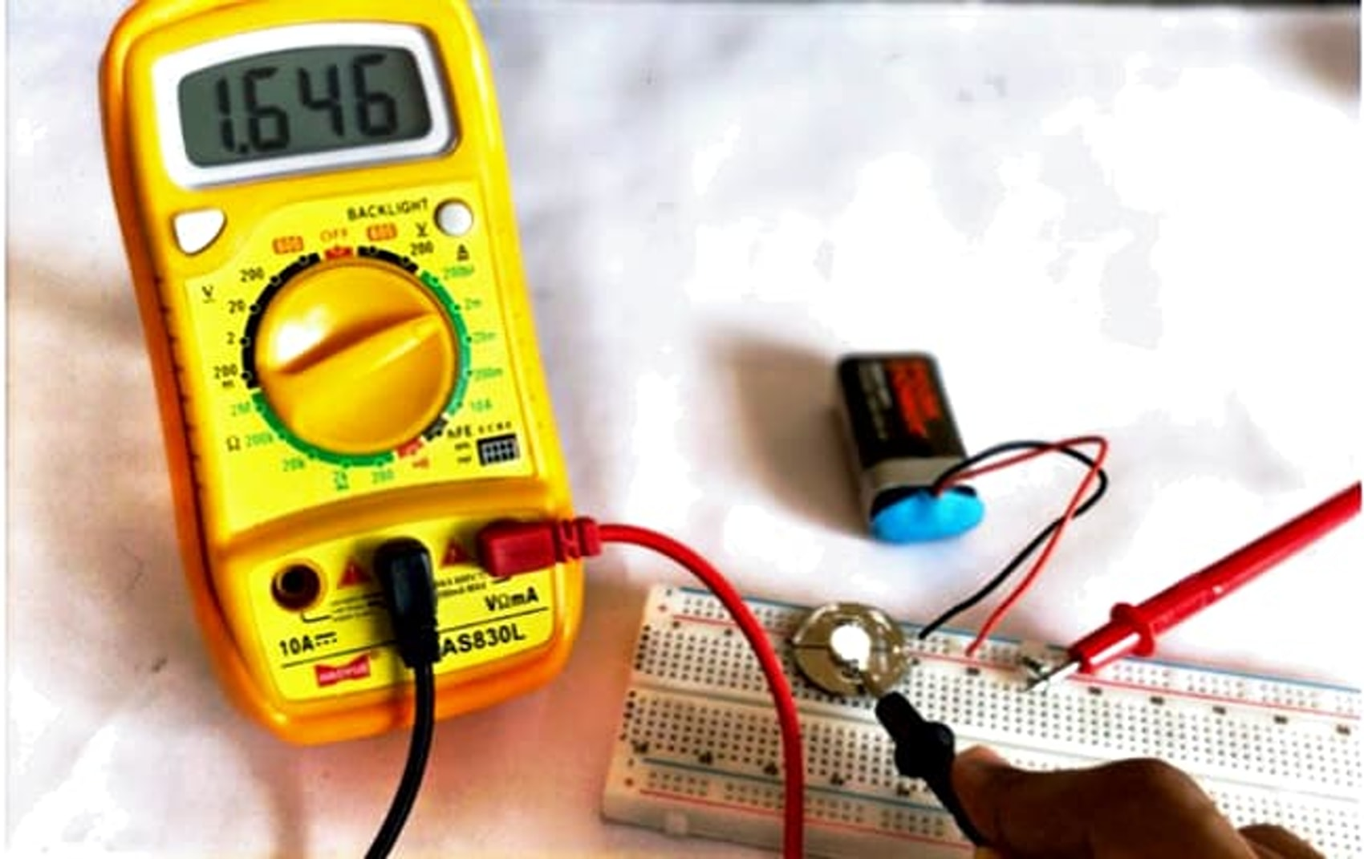
UNIT TESTING
Each component involved in the circuit is tested such that the product is soldered perfectly and the circuit flows in and out of Vcc and Gnd. A Multi-meter is used to test the Arduino Nano, HC-05 Bluetooth Module, Hi-link 3W Power Supply Module, VS1838 IR Sensor, S8050 NPN Transistors, Relays and Diodes.

Slide 25
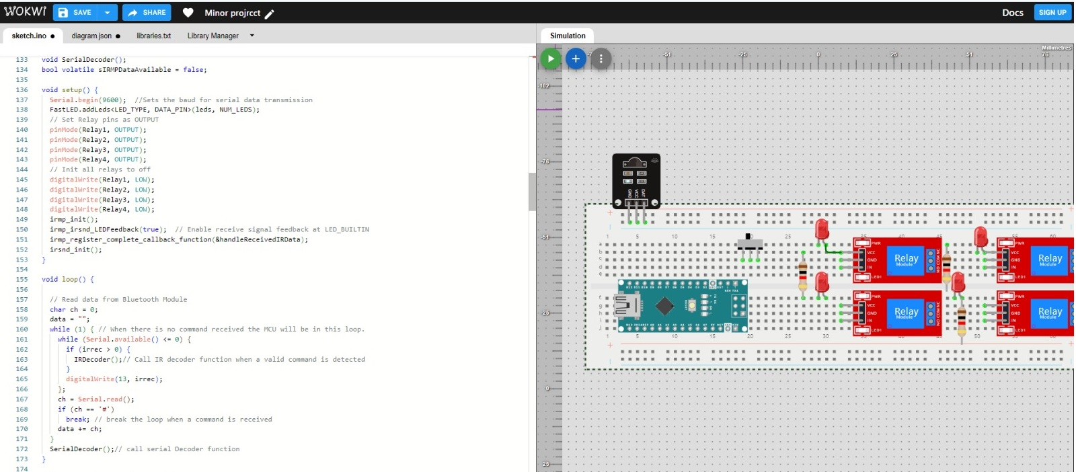
INTEGRATION TESTING
Now the entire components are connected in TinkerCAD for Visual Simulation for testing purpose the code is run into the Arduino and test runs are done. This simulation of the circuit and the code is tested in this phase.
The Arduino code has been uploaded and executed to validate the integrated system's performance.
This simulation allows us to test both the circuit connections and the code execution in a controlled environment.
By running test scenarios in this integrated setup, we can identify any compatibility issues, verify component interactions, and ensure that the entire system operates as expected.

Slide 26
SYSTEM TESTING
The testing will encompass various key areas, including integration testing to ensure seamless component interactions, functional testing to validate specific features, performance testing to assess system responsiveness and scalability, usability testing to evaluate user interface and experience, security testing to verify data protection measures, and compatibility testing to ensure interoperability across devices and platforms.
The testing process will involve developing test cases based on system requirements, executing them, documenting results, and prioritizing identified issues for resolution.
On Post Testing, we analyze the results, generate comprehensive reports, provide recommendations for improvements and prepare the system for deployment.
FUNCTIONAL TESTING
The testing will focus on verifying the accuracy of voice recognition, the system's ability to control connected devices based on voice commands, and its capability to execute multiple commands sequentially without errors.
We will also test the system's error handling mechanisms to ensure it provides appropriate feedback for invalid or unrecognized commands. Additionally, we will assess the system's security and privacy features to ensure it maintains security protocols and protects user privacy.

Slide 27
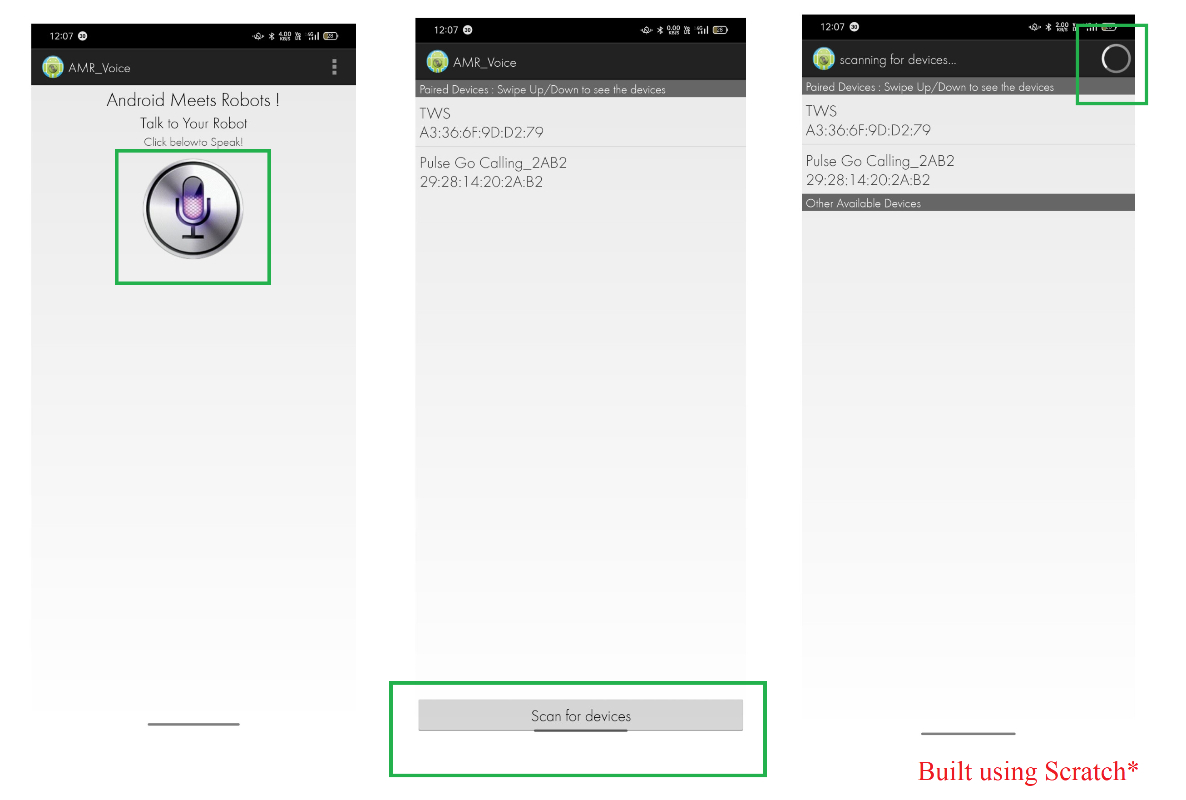
INPUT AND OUTPUT

Slide 28
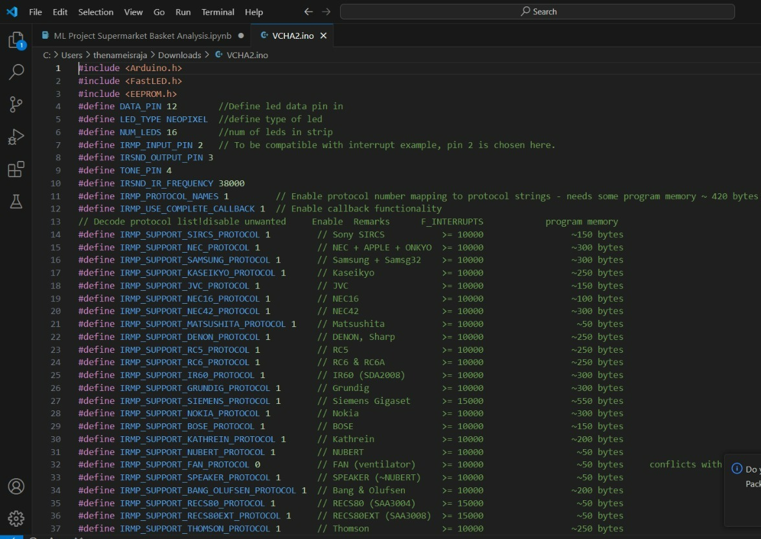
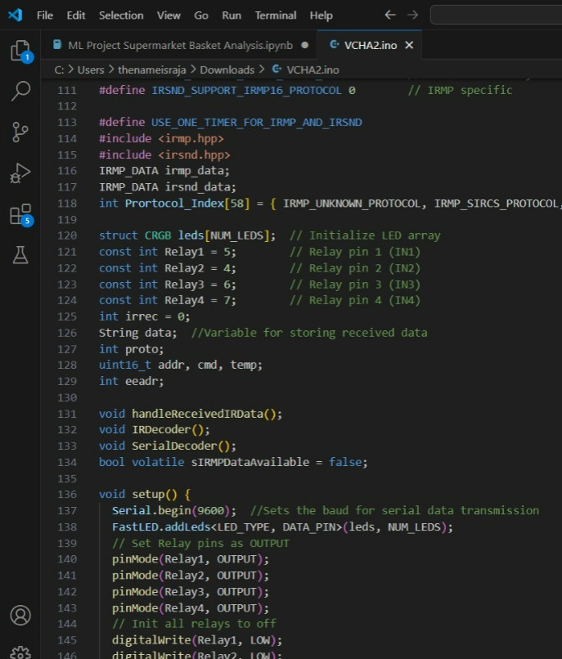
SOURCE CODE

Slide 29
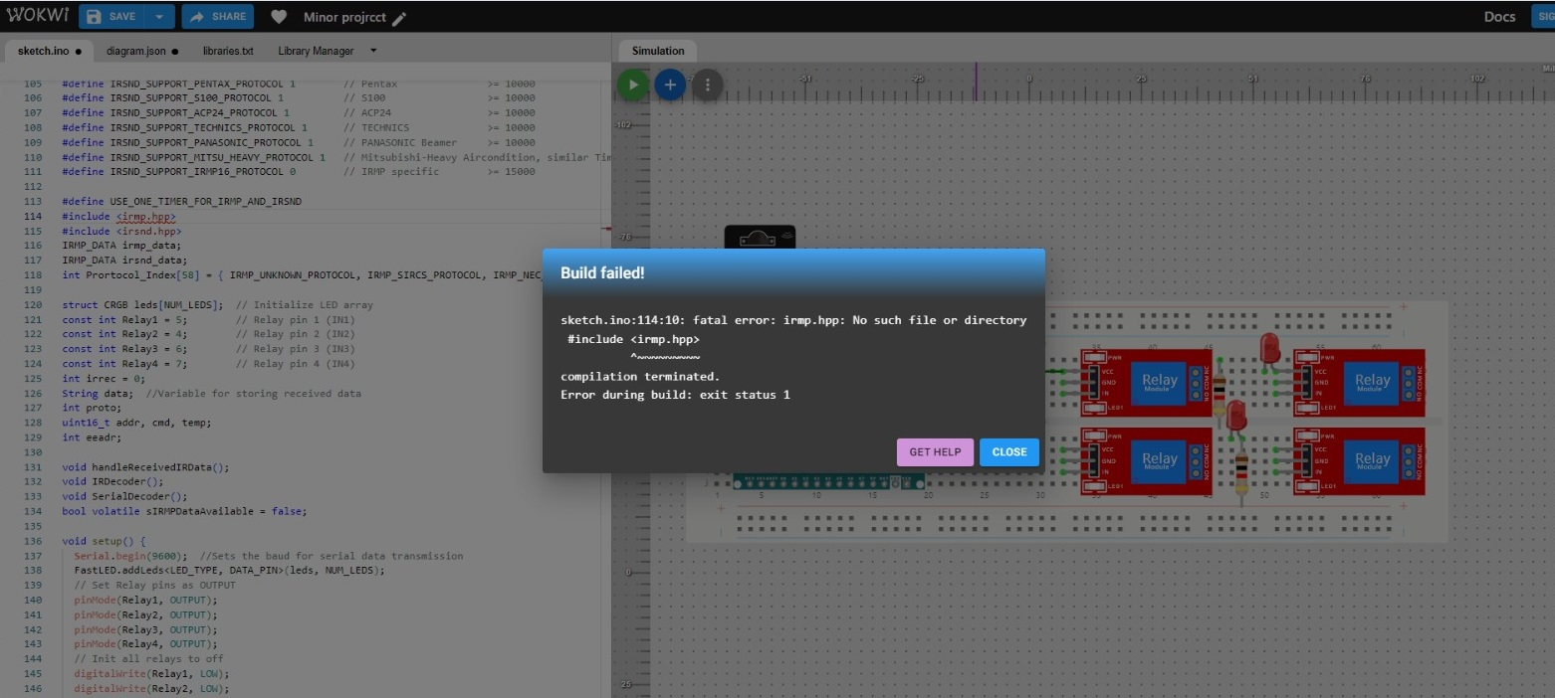
OUTPUT
Troubleshooting under progress*

Slide 30
CONCLUSION
Our voice-controlled home automation system has been successfully validated through comprehensive testing in TinkerCAD.
The system demonstrates seamless integration between hardware and software components, ensuring reliable and efficient operation.
Designed as a cost-effective solution, the system offers a user-friendly interface tailored to meet the specific needs of elderly and physically disabled individuals.
By enabling control of various home devices through intuitive voice commands, the system promotes independence and accessibility for users.
Our project reflects a commitment to leveraging technology for social good, aiming to enhance the quality of life and autonomy of its users.

Slide 31
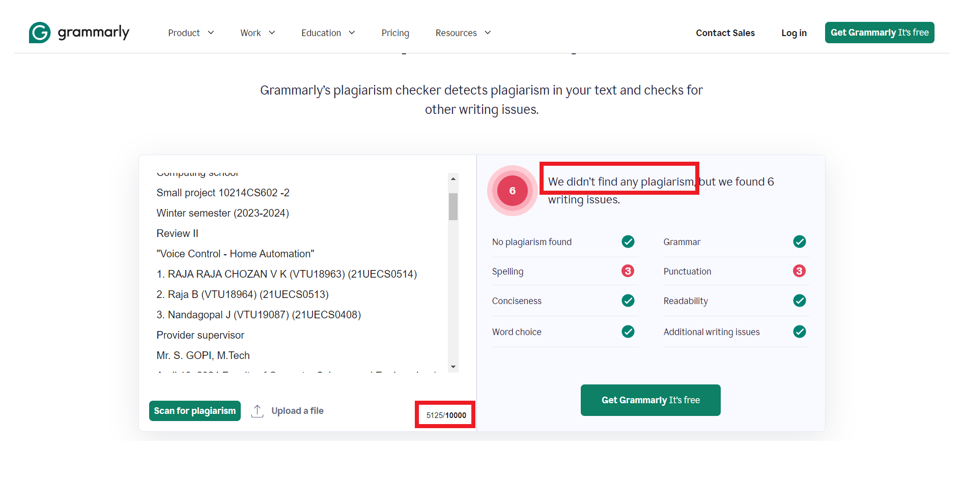
Plagiarism Report of PPT

Slide 32


Web references/video links
1. TED Talks on “How Dangerous are IoT Devices?” By Yuval Elovici. https://youtu.be/vgoX_m6Mkko?si=dmSJxdbnZCEtP3cK
2. IoT Learning by Great Learning. https://youtu.be/Fj02iTrWUx0?si=0oKwjm_FE9bAG_HS
3. IoT Network Simulator. https://networksimulationtools.com/iot-network-simulator/
4. Arduino Nano Leaning Configuration Guide. https://www.arduino.cc/en/Guide/ArduinoNano

Slide 33
REFERENCES
[1] Froiz-Míguez, I., Fraga-Lamas, P., & Fernández-CaraméS, T. M. (2023). Design, Implementation, and Practical Evaluation of a Voice Recognition Based IoT Home Automation System for Low-Resource Languages and Resource-Constrained Edge IoT Devices: A System for Galician and Mobile Opportunistic Scenarios. In IEEE Access (Vol. 11, pp. 63623-63649). DOI: 10.1109/ACCESS.2023.3286391.
[2] Arif, T., Javed, A., Alhameed, M., Jeribi, F., & Tahir, A. (2021). Voice Spoofing Countermeasure for Logical Access Attacks Detection. In IEEE Access (Vol. 9, pp. 162857-162868). DOI: 10.1109/ACCESS.2021.3133134.
[3] Butun, I., & Österberg, P. (2021). A Review of Distributed Access Control for Blockchain Systems Towards Securing the Internet of Things. In IEEE Access (Vol. 9, pp. 5428-5441). DOI: 10.1109/ACCESS.2020.3047902.
[4] Pourvahab, M., & Ekbatanifard, G. (2019). An Efficient Forensics Architecture in Software-Defined Networking-IoT Using Blockchain Technology. In IEEE Access (Vol. 7, pp. 99573-99588). DOI: 10.1109/ACCESS.2019.2930345.
[5] P. R. Pinheiro et al., "Integration of the Mobile Robot and Internet of Things to Monitor Older People," in IEEE Access, vol. 8, pp. 138922-138933, 2020, doi: 10.1109/ACCESS.2020.3009167.

Slide 34
[5] A. Al-Nasheri et al., "Voice Pathology Detection and Classification Using Auto-Correlation and Entropy Features in Different Frequency Regions," in IEEE Access, vol. 6, pp. 6961-6974, 2018, doi: 10.1109/ACCESS.2017.2696056.
[6] A. Sehgal and N. Kehtarnavaz, "A Convolutional Neural Network Smartphone App for Real-Time Voice Activity Detection," in IEEE Access, vol. 6, pp. 9017-9026, 2018, doi: 10.1109/ACCESS.2018.2800728.
[7] J. Mabrouki, M. Azrour, D. Dhiba, Y. Farhaoui, and S. E. Hajjaji, "IoT-based data logger for weather monitoring using Arduino-based wireless sensor networks with remote graphical application and alerts," in Big Data Mining and Analytics, vol. 4, no. 1, pp. 25-32, March 2021, doi: 10.26599/BDMA.2020.9020018.

Slide 35
THANK YOU

